Slide 1
IPEX Correspondents‘ Meeting
5-6 November 2015, Vienna
Best Practice – EU Databases of National Parliaments:
EuDoX: The Information System
in matters concerning the
European Union in the
German Bundestag
Dr. Birgit von Pflug, Head of Division on European Affairs Documentation

Slide 2
Legal framework for participation in EU affairs
EU primary law
Treaty of Lisbon (Article 12 TEU, Protocol nr 1 and nr 2), in force
since 1 December 2009
German Basic Law
Basic Law: Article 23 (1) – (3) and Article 45 of the Basic Law, in force since
25 December 1992
German national legislation
Act on Cooperation between the Federal Government and the German Bundestag in Matters concerning the European Union of 12 March 1993 (Cooperation Act), in the version of
4 July 2013
Act on the Exercise by the Bundestag and by the Bundesrat of their Responsibility for Integration in Matters concerning the European Union of 22 September 2009 (Responsibility for Integration Act)
Act on the Assumption of Guarantees within the Framework of a European Stabilisation Mechanism of 23 May 2010 (Stabilisation Mechanism Act)
Act on Financial Participation in the European Stability Mechanism of 13 September 2012 (ESM Financing Act)
Rules of Procedure of the German Bundestag
(in particular) Rule 93 and Rule 93 a-d

Slide 3
The Bundestag’s rights to receive information
under the Cooperation Act - Part I
The Federal Government shall keep the Bundestag informed, comprehensively and at the earliest possible time on matters concerning the European Union:
Formal forwarding of EU documents (‘projects’) with a forwarding letter, a report, plus a comprehensive appraisal for legislative acts.
Green and White Papers
Commission communications
Proposals for directives and regulations
Negotiating mandates for international treaties, initiatives and negotiation guidelines in the framework of the common commercial policy and the world trade
General forwarding of EU documents such as reports from the Council or the Commission, follow-up documents, initiatives and opinions of the Federal Government or other Member States.

Slide 4
The Bundestag’s rights to receive information
under the Cooperation Act – Part II
The Federal Government’s other notification and reporting obligations:
  Written preparatory and follow-up reports by the federal ministries on meetings of the Council and the European Council
  Reports from the Permanent Representation regarding meetings of Council working groups and of the Committee of Permanent Representatives (including instructions)
  Notifications about the institution of infringement proceedings under Articles 258, 260 TFEU
  Early-warning reports
  Reports on trilogues
  Reports on legislative acts within the meaning of Articles 290, 291 TFEU (previously comitology)
  Special notifications in the context of the Common Foreign and Security Policy/Common Security and Defence Policy
  Oral notification from the federal ministries
  On request: preparatory papers and unofficial documents from the Commission and the Council

Slide 5
EuDoX
EuDoX has a dossier-based structure, with all of the documents received by the German Bundestag – around 25,000 per year – assigned to dossiers devoted to specific projects, meetings or subjects, or miscellaneous dossiers.
The document management system‘s strength lies in the combination of the different documents
  of the EU
  of the Federal Government
  of the German Bundestag
    Active and regular informationen
  with pre-defined Newsletters
  observation of dossiers
  creation of speaking notes

Slide 6
Sources of Documents
EU
German Parliaments
EU-Documents
Committee Documents
Fed. Govt.
Resolutions of the
Bundestag/Bundesrat
Formal Reports/
Comprehensive Appraisals
of Fed. Govt.
Project-Dossier
Communications
/Memos/Cables
of the Fed. Govt.
Reports from Brussels
Other Documents
esp. EFSF/ESM
Internal Memos
of the Bundestag

Slide 7
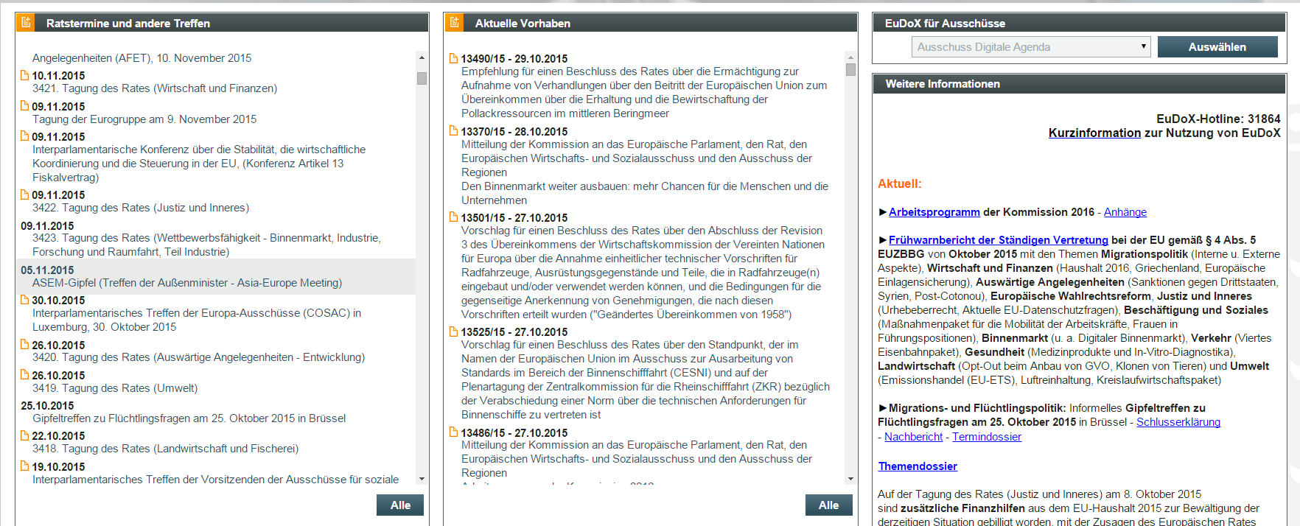
Main Portal
forthcoming Council and other meetings
current EU projects
further information

Slide 8
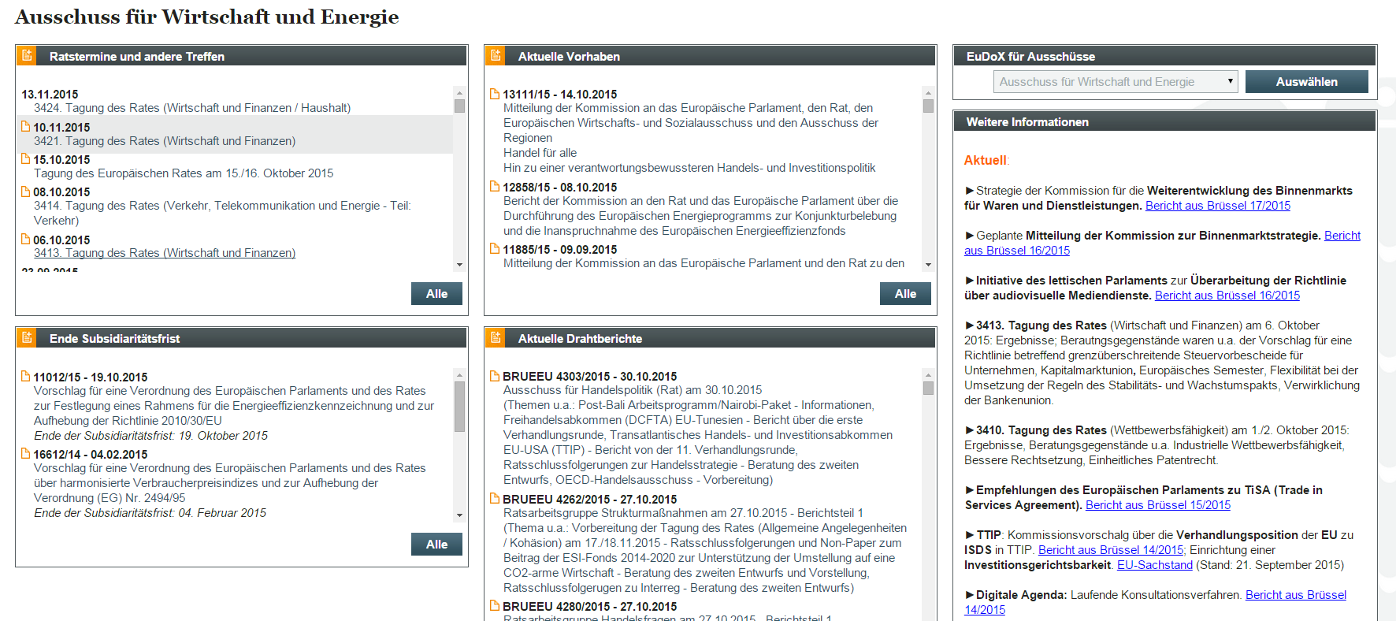
Committee Portals
reports from the Permanent Representation
expiring indicative deadlines
access to committee portals

Slide 9
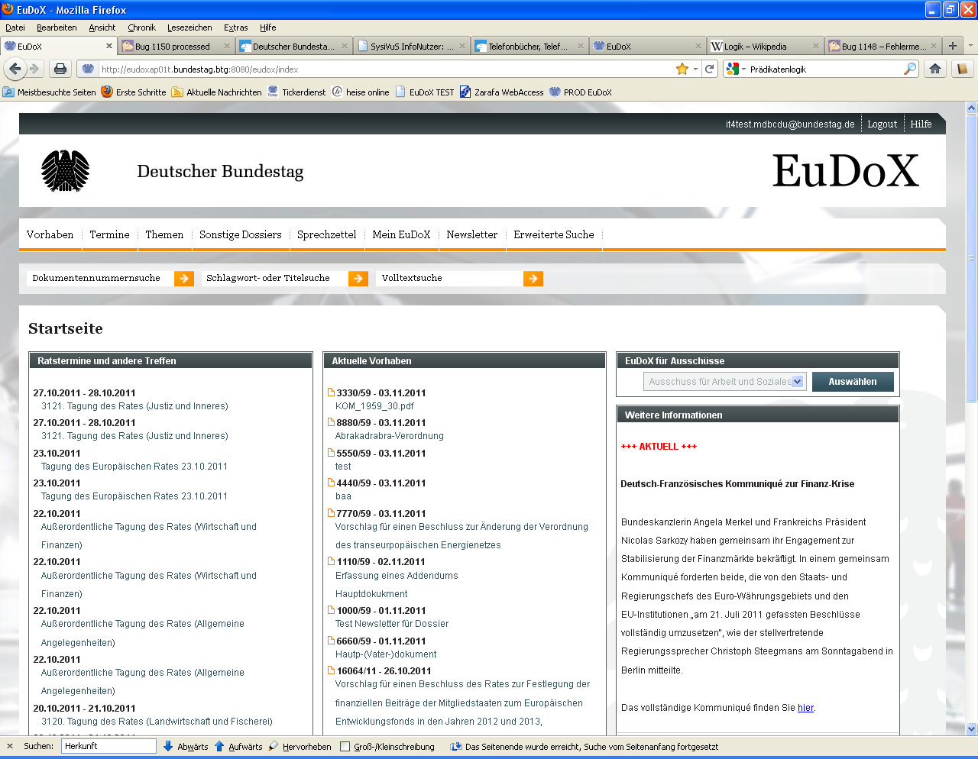
Page Design and Navigation
  The header with main menue and quick search
    Search Options
    Search with the document number
    Search with key word or subject
    Search in the full text
    Search with metadata (Advanced Search)

Slide 10
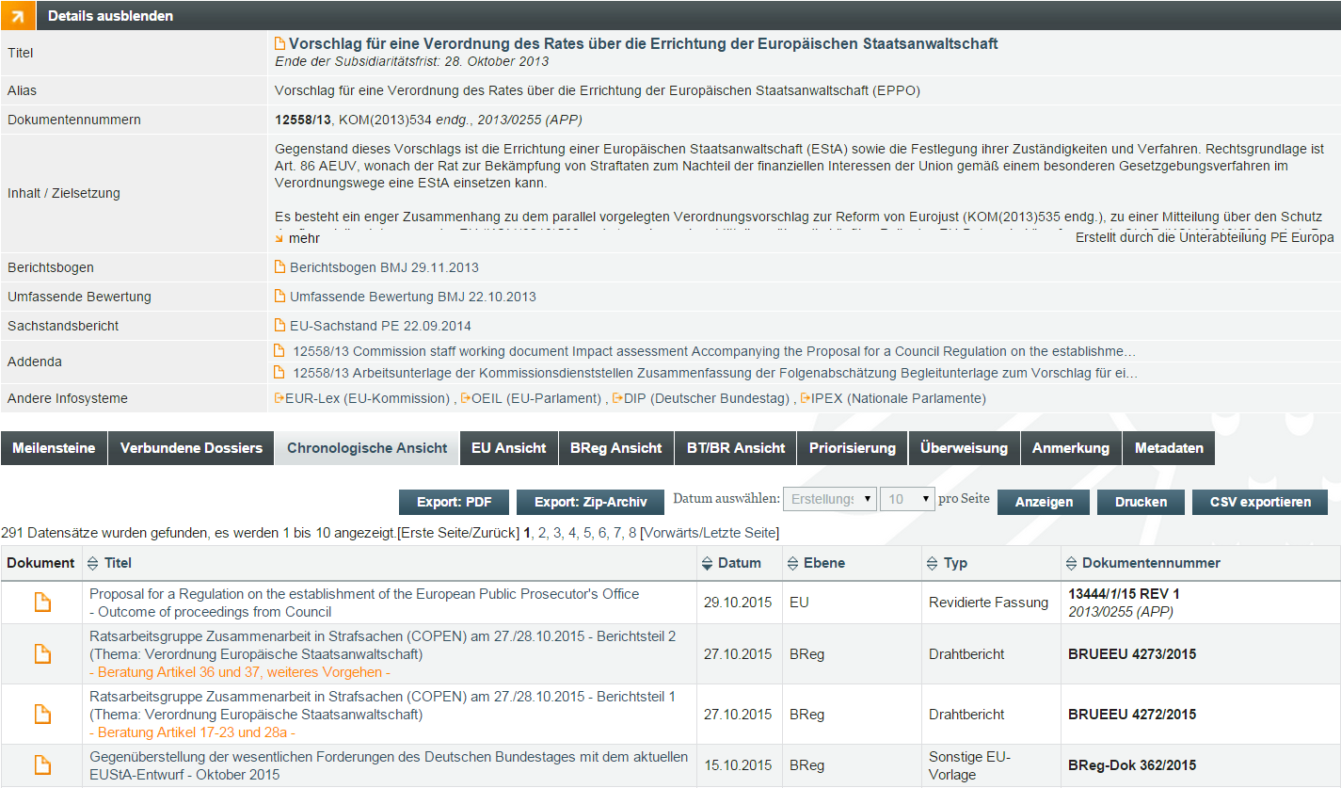
Main elements of EuDoX –
Projects (Vorhaben)

Slide 11
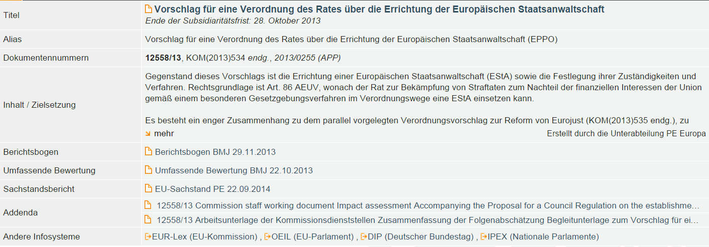
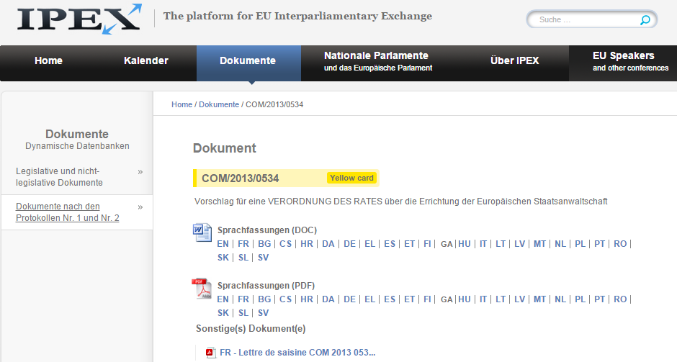
Link to IPEX

Slide 12
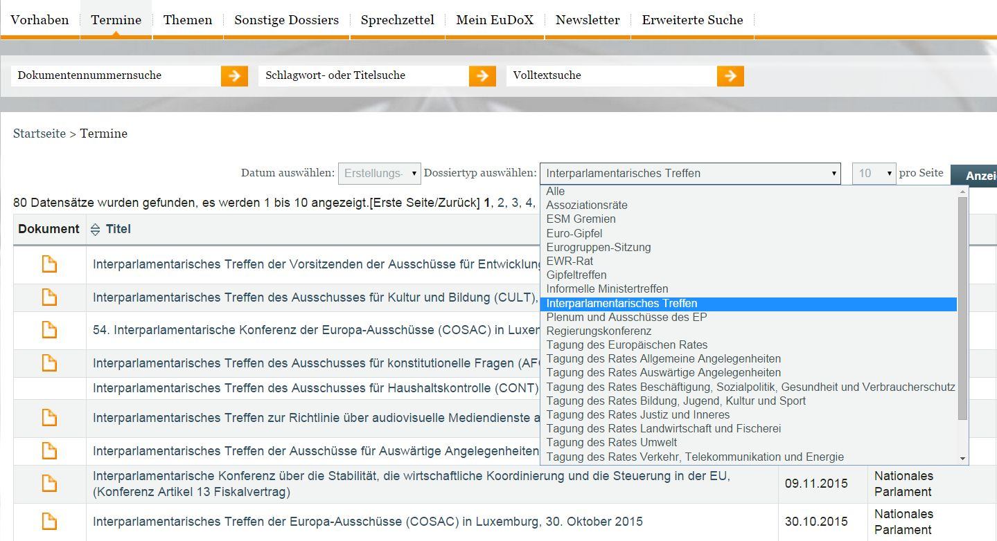
Main elements of EuDoX –
Meetings (Termine)

Slide 13
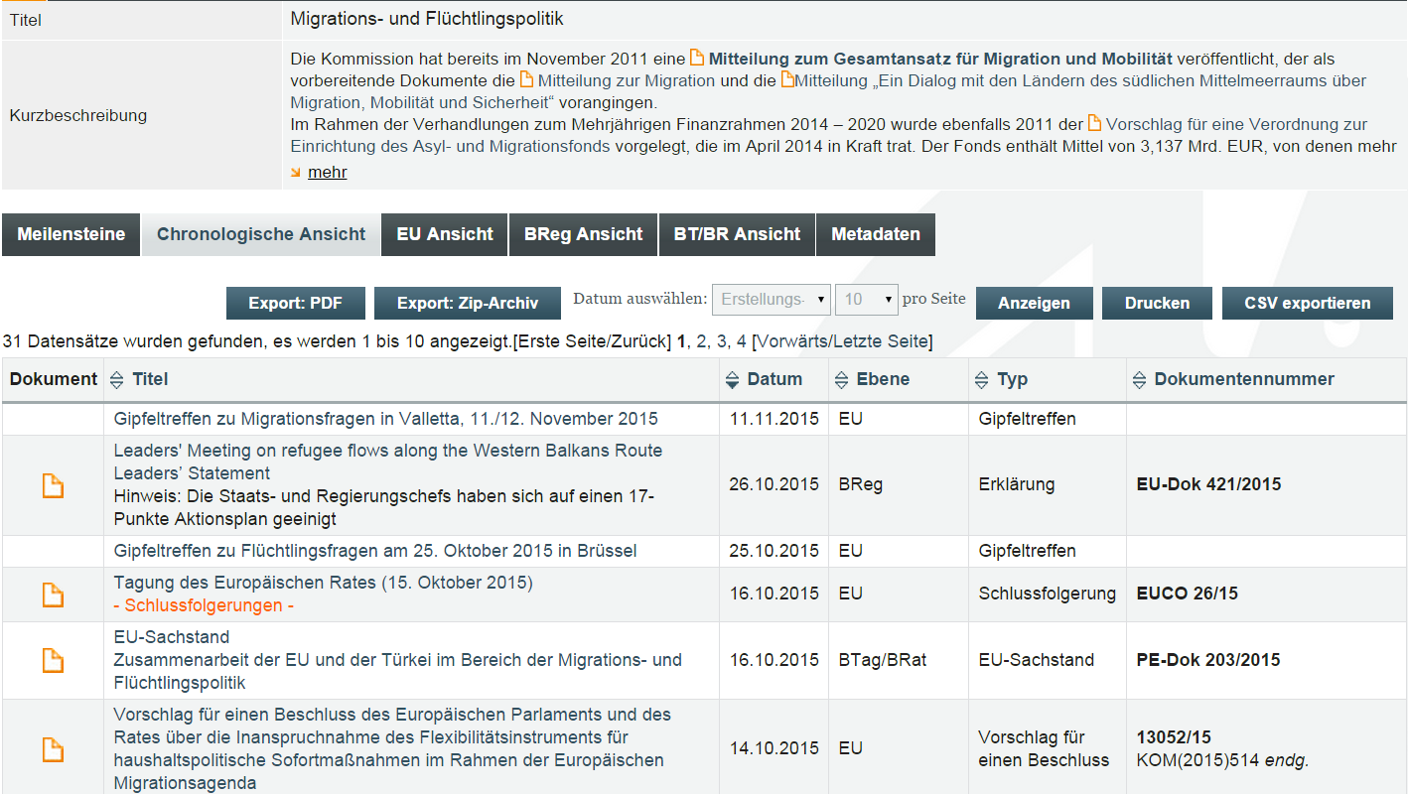
Main elements of EuDoX –
Subject dossiers (Themen)

Slide 14
Thank you!
For further information please contact:
Dr. Birgit von Pflug
Deutscher Bundestag
Referat PE 5 Europa-Dokumentation
Platz der Republik 1
D-11011 Berlin
Telefon: +49 (0) 30 227-34364
Telefax: +49 (0) 30 227-30063

